Slide 1
SMART Roads
-by akshay choudhary
NUID :001630590

Slide 2
Problem Statement
The improper road conditions has led to a number of disruptions in the past few years and there isn't any approach to address such situation. This is an ever-growing problem that needs to be addressed with some system which will monitor the situations in real-time and implement the solutions to it.

Slide 3
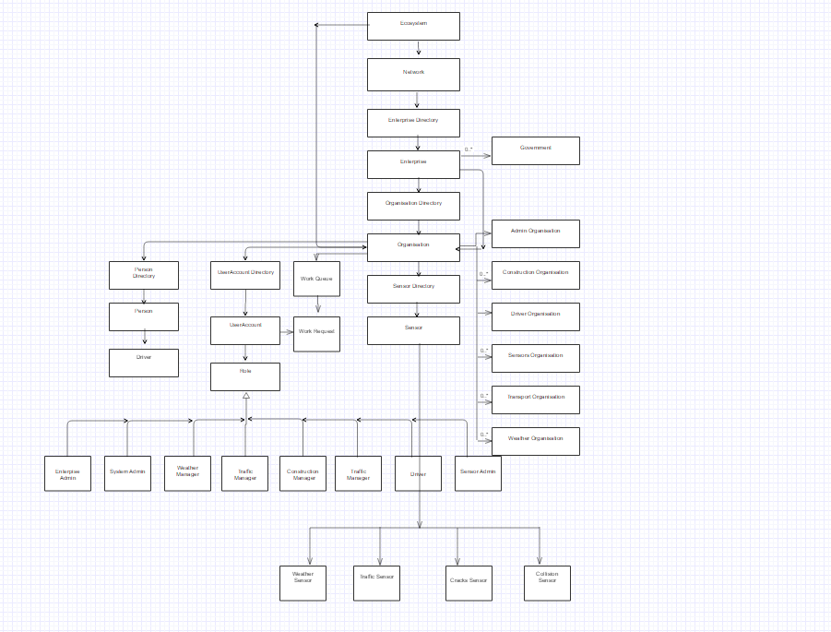
Object Model

Slide 4
Roles
SysAdmin
Admin
Sensoradmin
Weather manager
Traffic Manager
Driver
Construction manager

Slide 5
Key Features
Sensor reports any information about the abnormal conditions in the enovironment to the different managers.
Managers then acknowledge sensoradmin that they have taken adequate steps and reported it to the driver
Driver then logs in and can see the alerts by different managers in the form of email or they can hear it through voice.

Slide 6
Extra Features
Simulation achieved via Threads
Email feature
Device to other Roles

